Slide 1


Slide 2
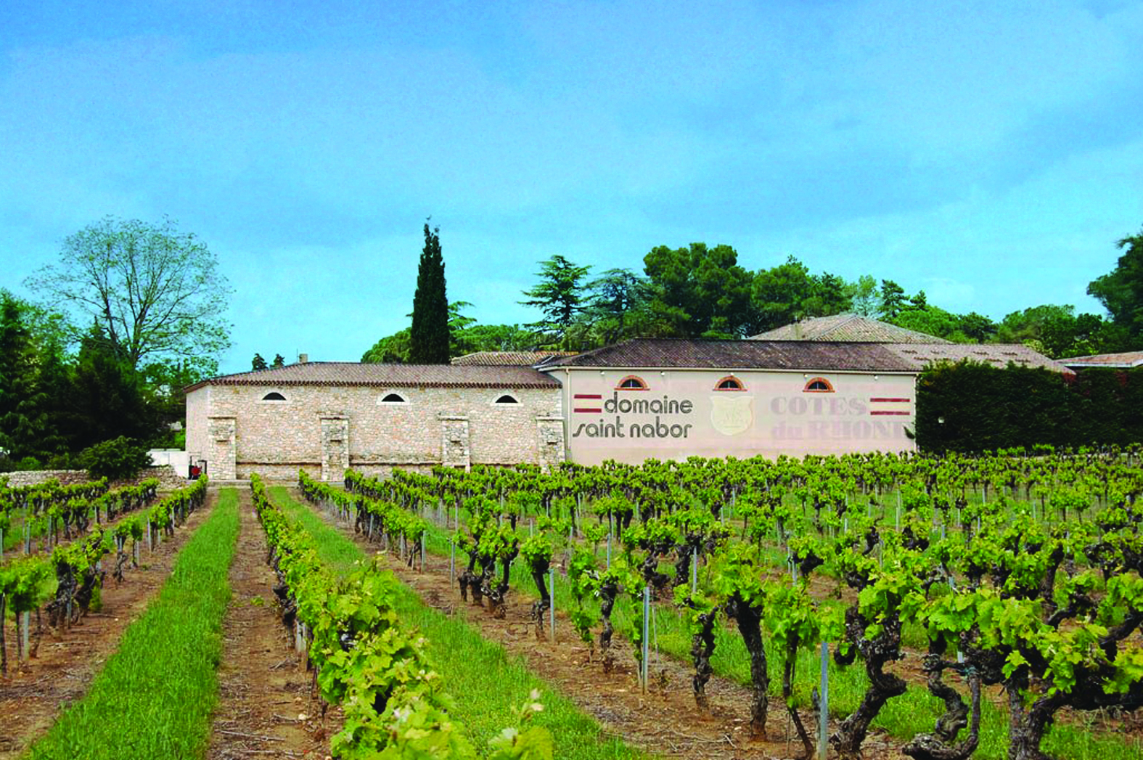

Slide 3
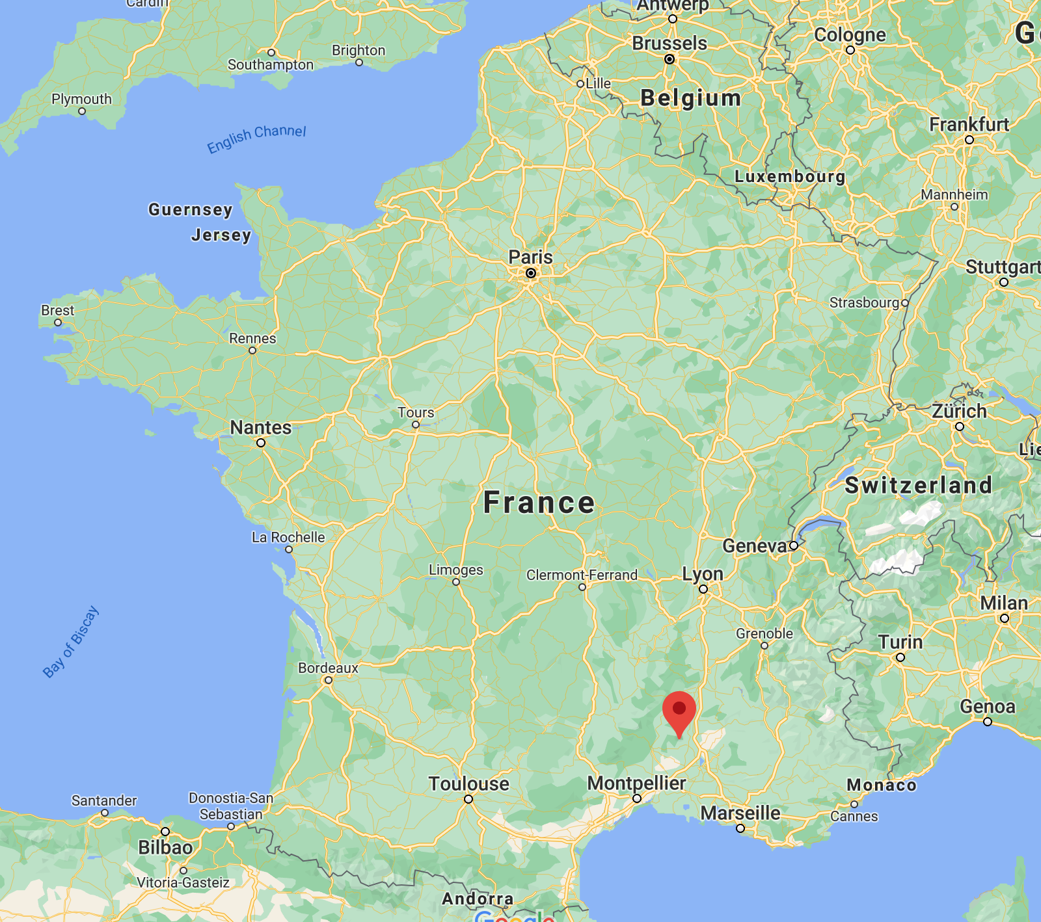
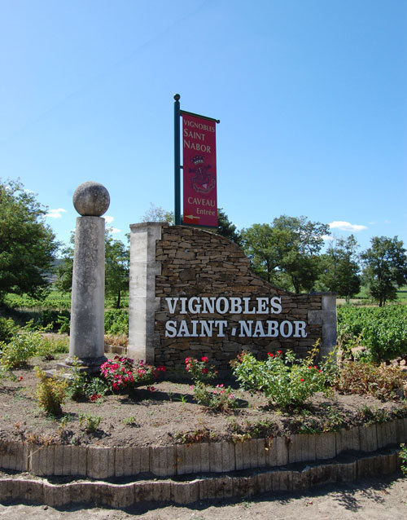
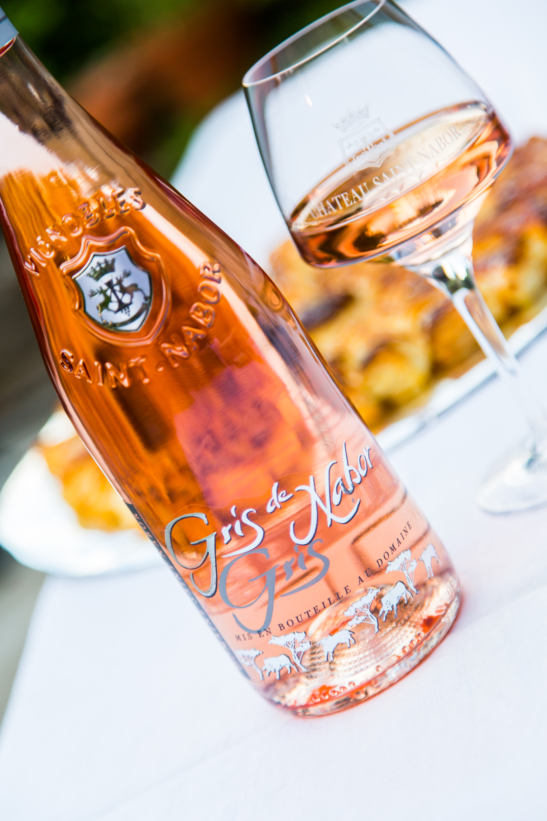
Intro
The history of this Rhône Valley family estate goes back a few centuries. To prove it, the current tasting room is located in the remains of an 11th century chapel.
Located in the tiny town of Cornillon in southeast France.
Agriculture on the estate is conducted in a manner in which the environment is respected; this is called Sustainable Agriculture ("Agriculture Raisonnée").
In 1972 the tasting room opened to the public. Chateau Saint Nabor was the first to open a tasting room in the Cèze Valley, a famous tourist area, and the first estate to sell bottled wines.
Each glass bottle bears the name and symbol of Vignobles Saint Nabor, an homage to the history and uniqueness of the region.

Slide 4
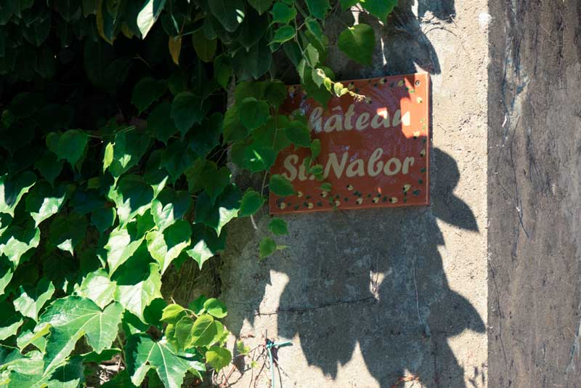

Slide 5
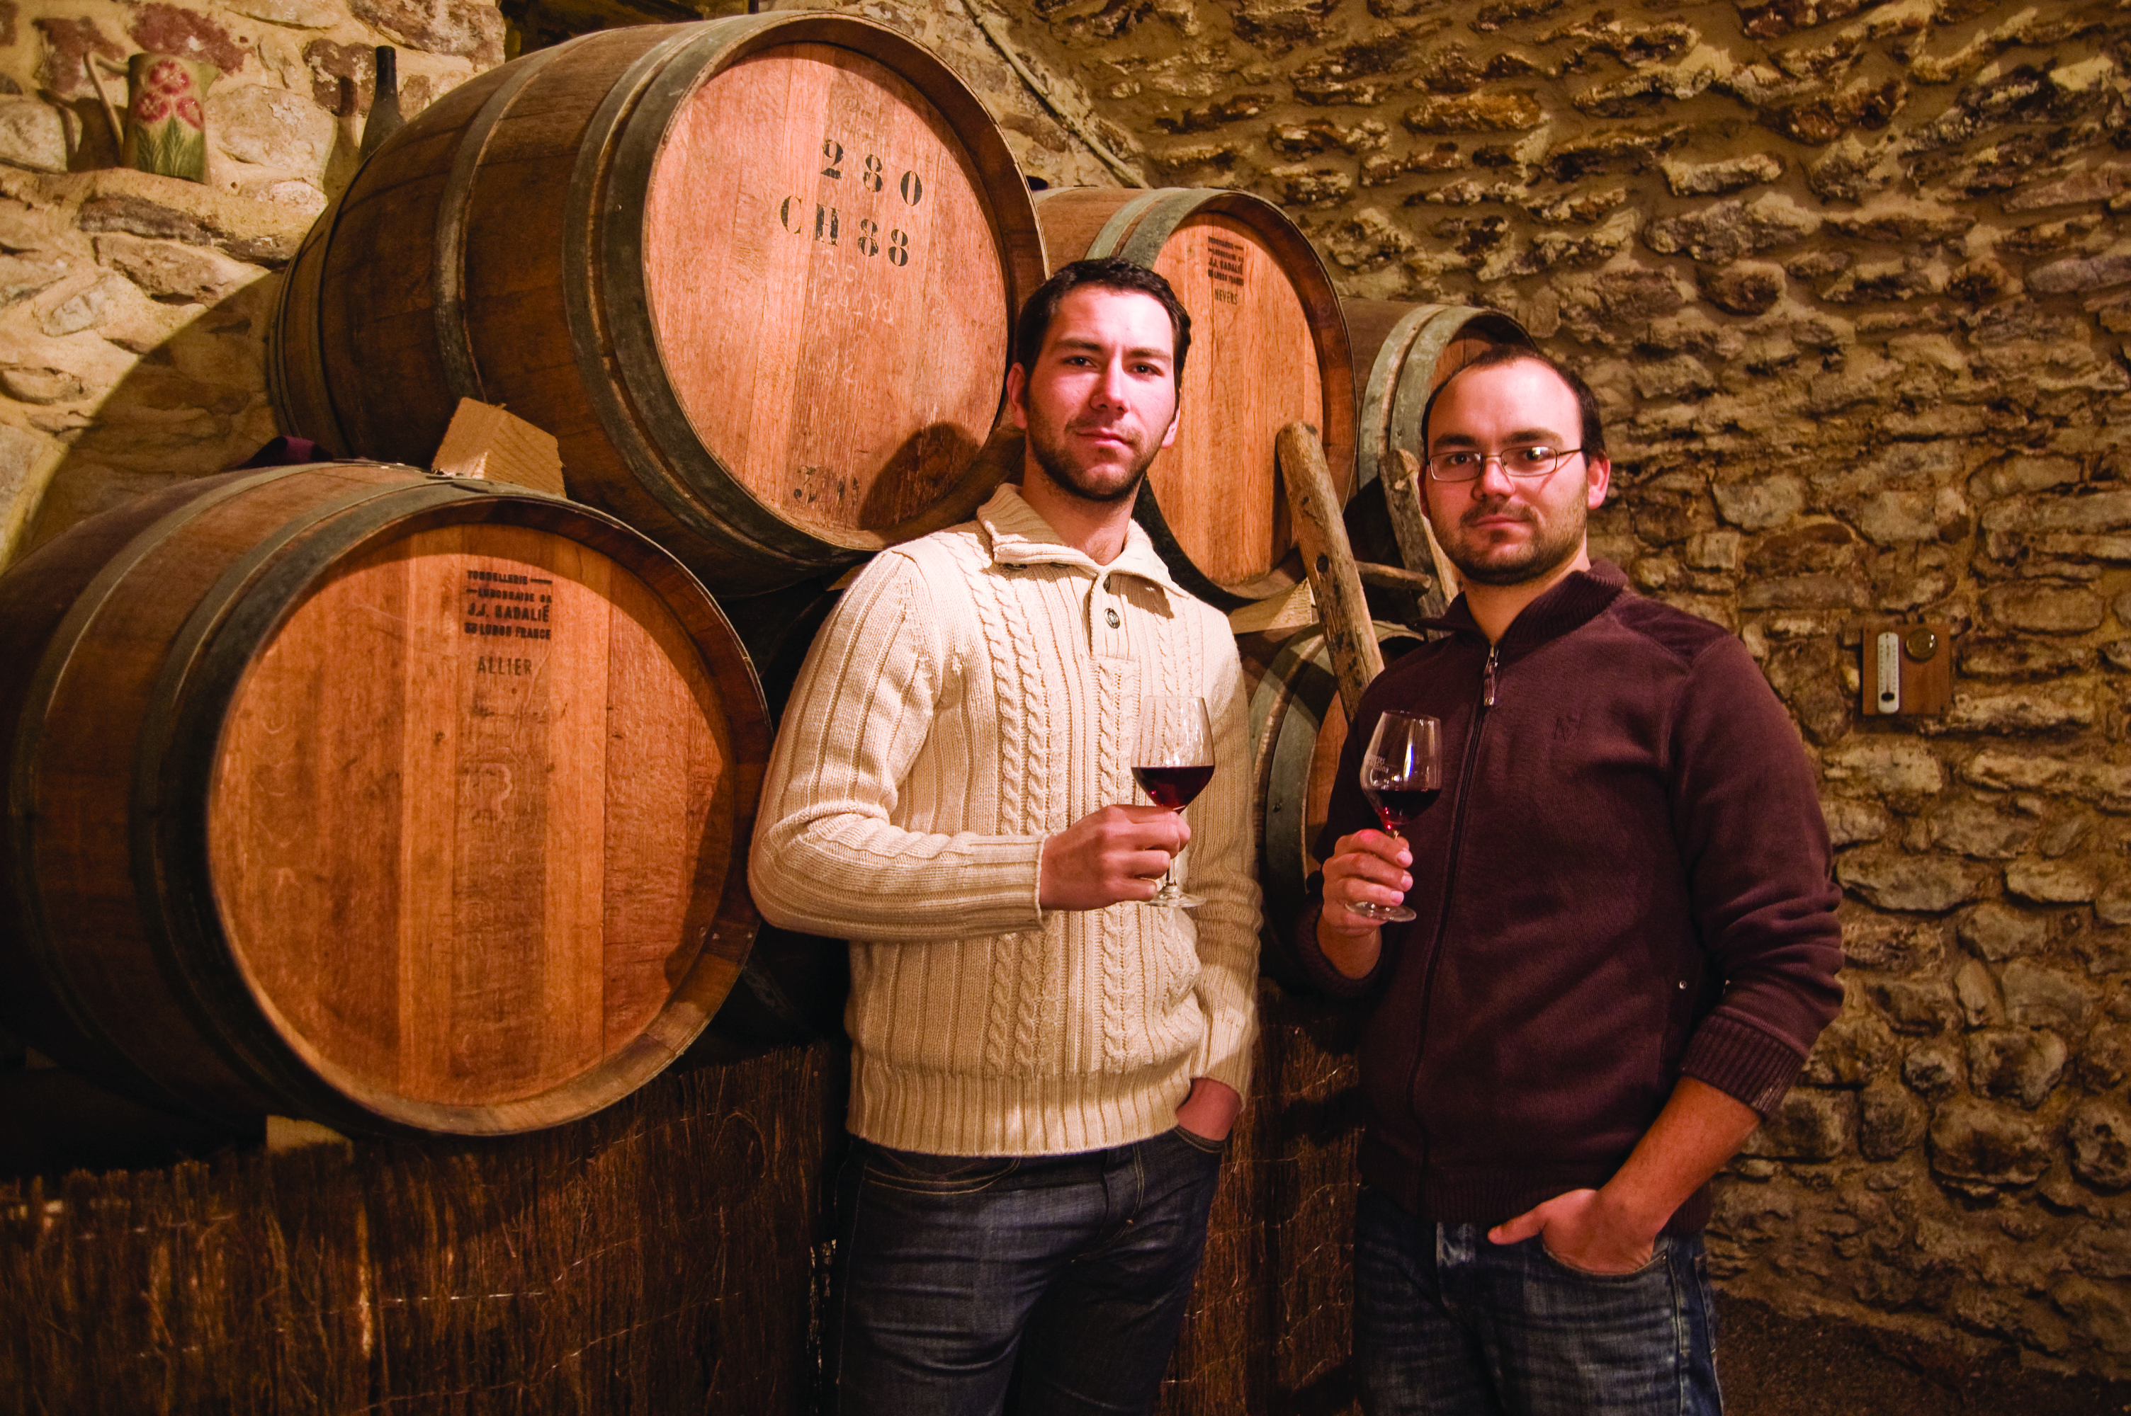
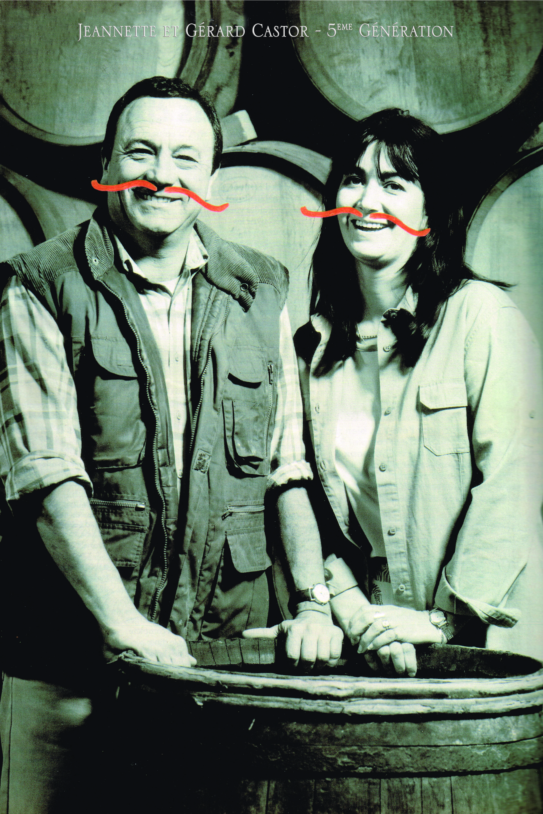
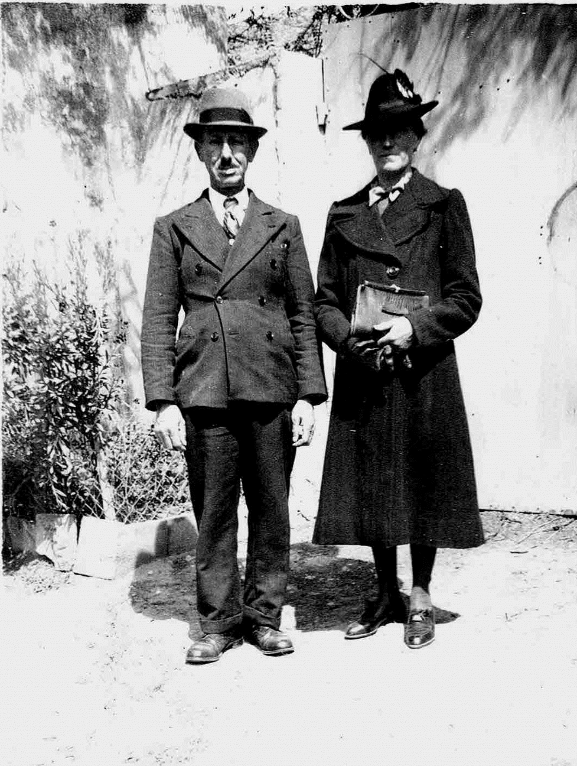
A Family Affair
Vintners from father to son for 6 generations; the Castor family is an example of continuity and tradition.
From 1870 through 1945, wine production was small and mostly for the family's own consumption during the first three Castor generations.
The terroir of Cornillon was classified AOC Côtes du Rhône in 1972, after a long fight by fourth generation owner, Edmond Castor.
Gérard Castor took control after his father’s untimely death and saw to increasing vineyard plantings with a focus on quality wine production.
In 2011, Gérard’s two sons, Jérémie and Raphaël took the reins from their father to steer the business into the future.

Slide 6
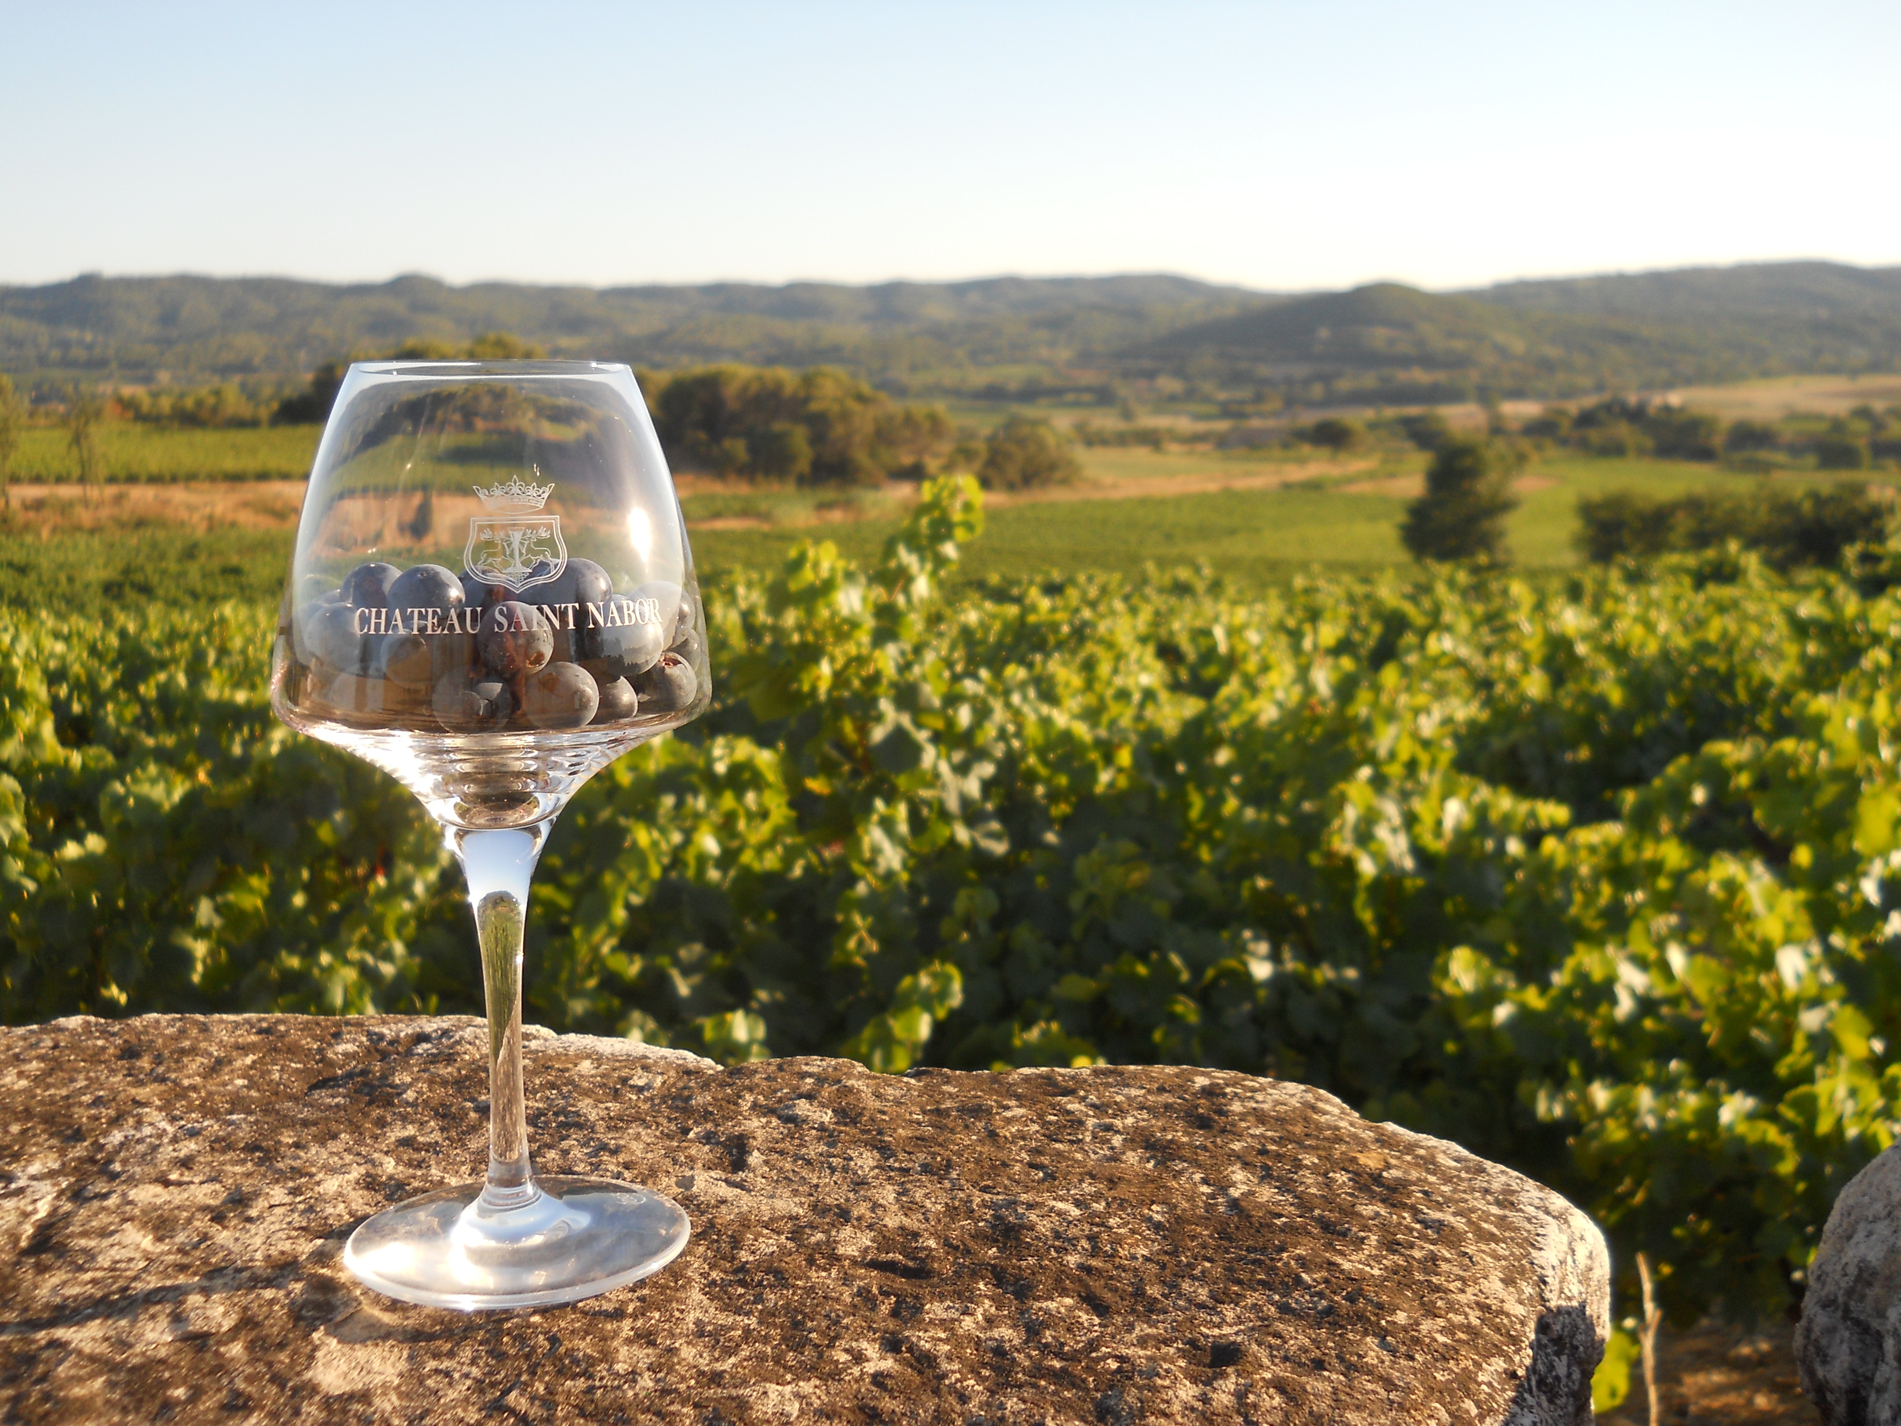

Slide 7
The Vineyards
Diverse Terroir brings personality to the wines.
The soils on the terraces are chalk and clay with various amounts of rocks, which produce powerful and well structured wines.
The soils on the low-hillside and plains are sand and clay with limestone and gravel, which produce fresh and fruity wines.
Machine harvesters have been used for over 20 years to harvest the grapes. During those years, the vineyards have been established to accommodate the machine. Knowledge has also expanded, which allows achieving quality equal to that of a manual harvest.
Using this machine, it takes 5 weeks to harvest all the grapes for the season and allows for a quick reaction if an emergency situation should arise.

Slide 8
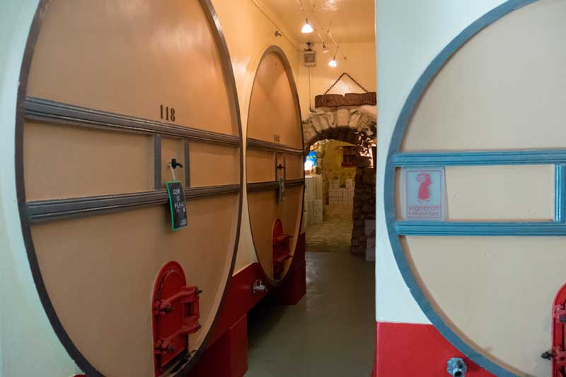

Slide 9
The Cellar
The very functional cellar is designed in a straight line, divided into two sections: the 1st where the red wines are produced and the 2nd where rose and white wines are produced.
Each tank is temperature-controlled, equipped with a cooling system. This system allows for total control over each fermenting tank to extract all the fantastic fruit characters.
The grapes are pressed with the greatest care with a membrane press.
In order to express the best characters of each wine, some are aged only in tanks while others receive a few months in neutral French oak barrels.
All the wines are filtered by cross-flow filtration and are bottled on the estate.

Slide 10
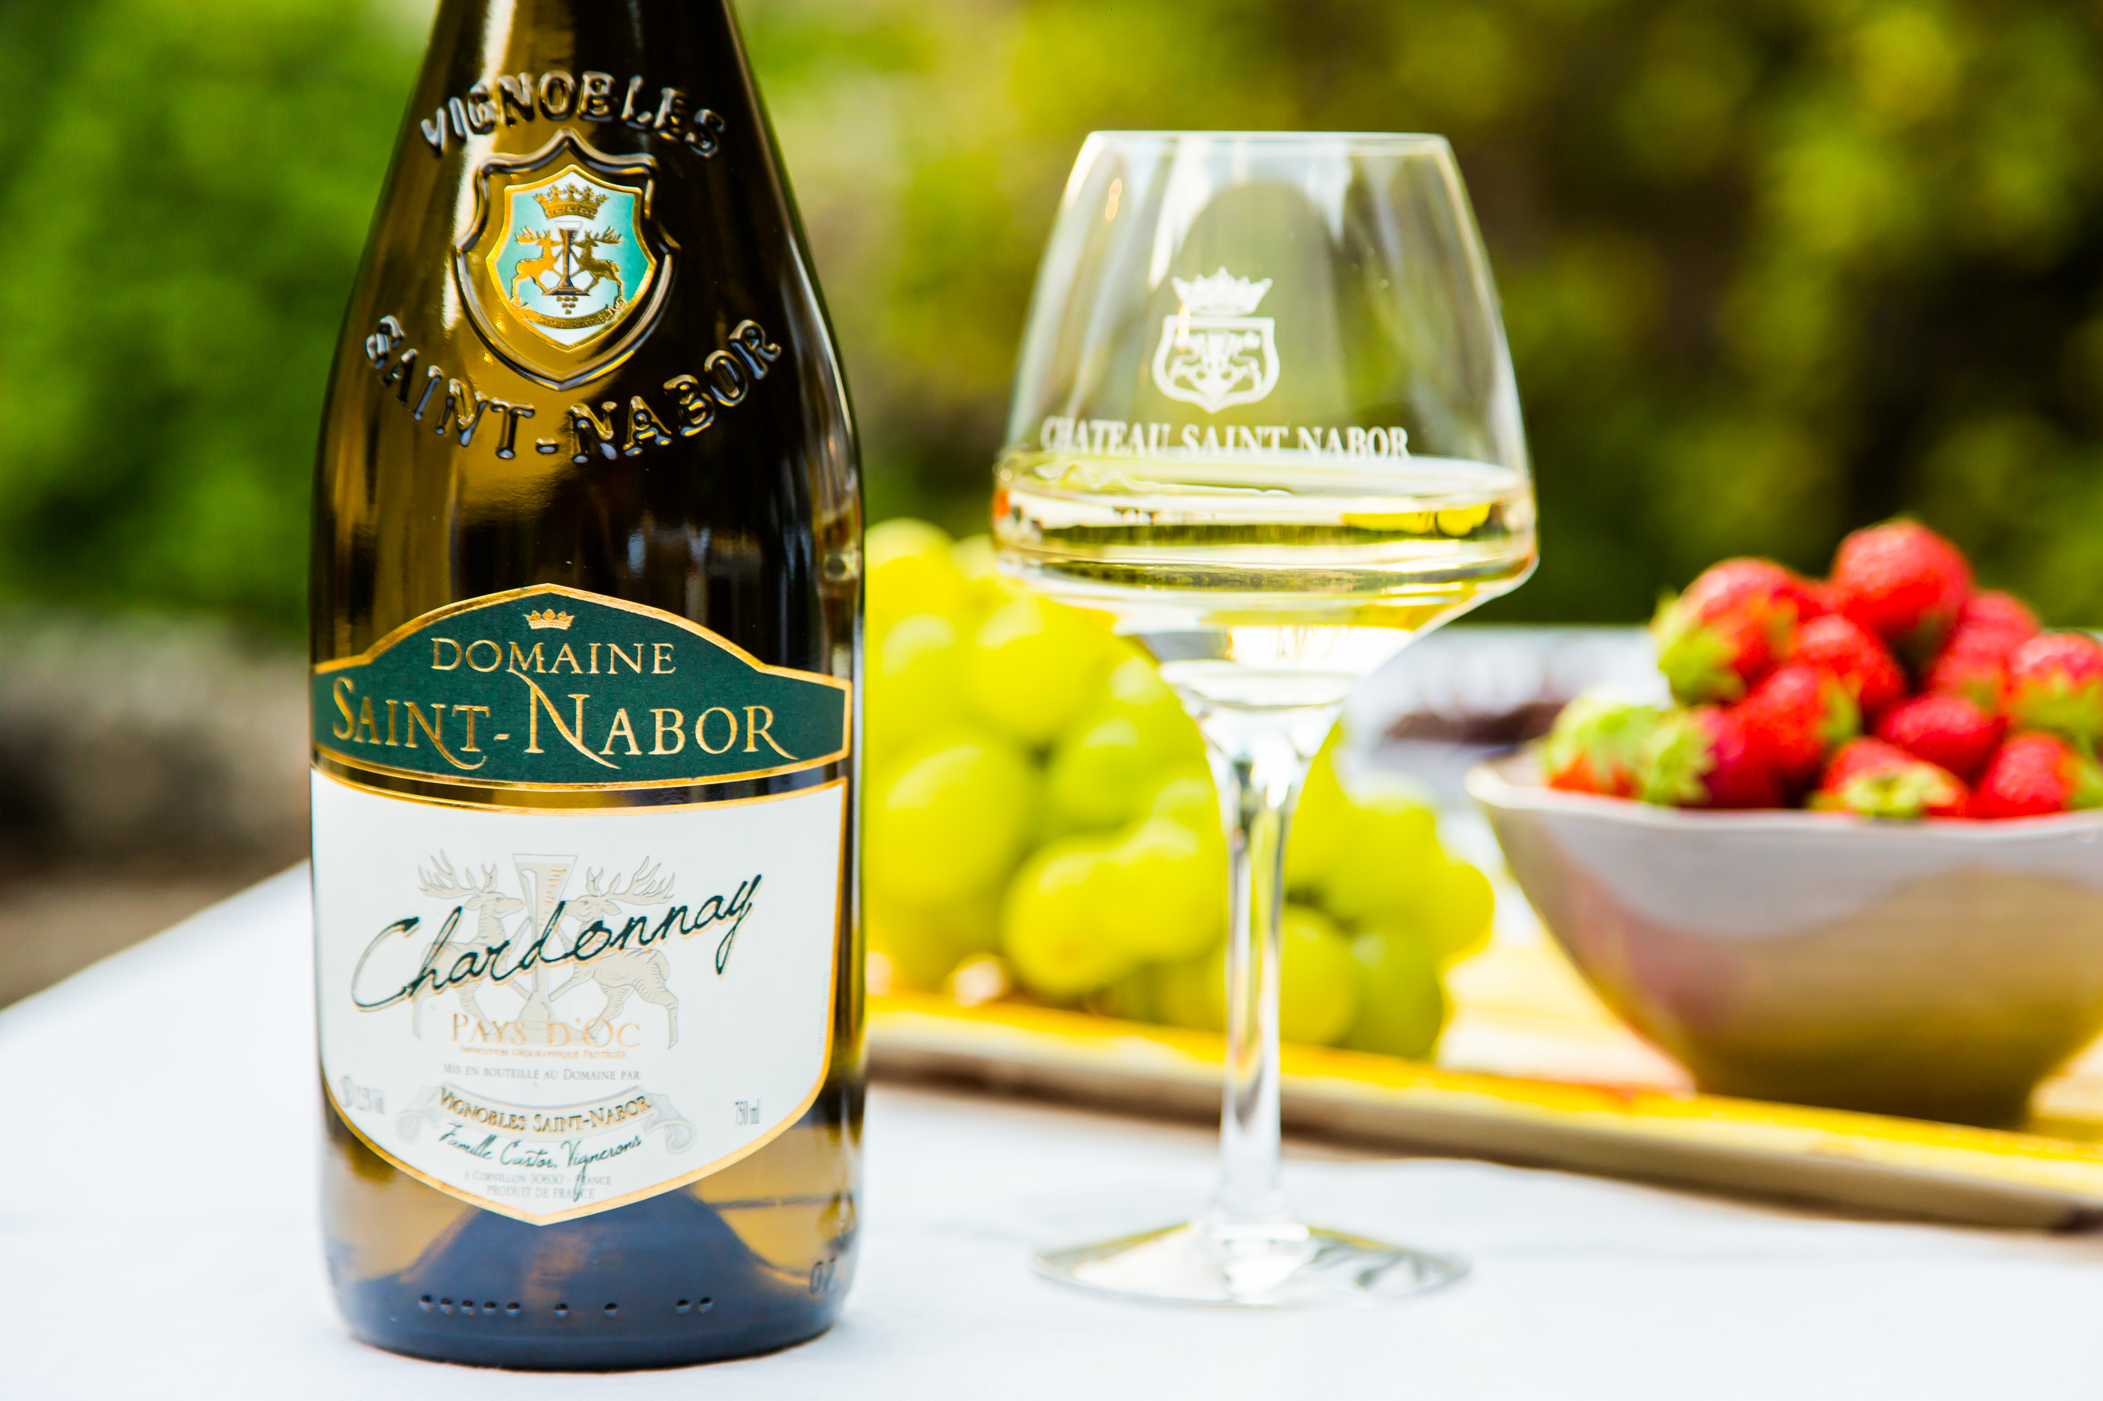

Slide 11
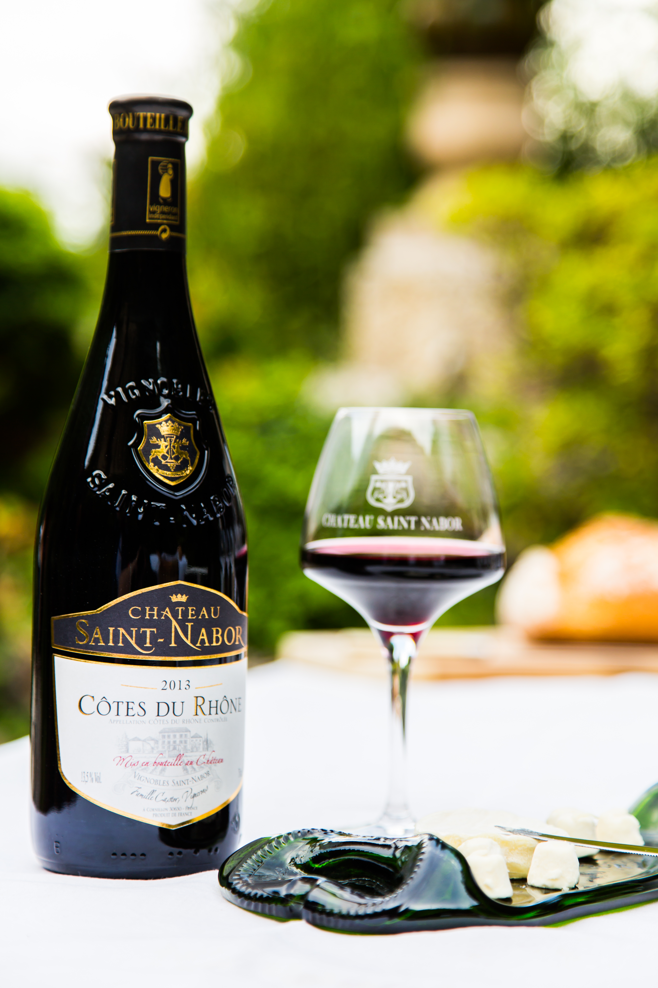
The Wines
All Chateau Saint Nabor wines are produced solely from estate fruit and carry the "Vignerons Independants" (Independent Producers) designation.
The grape varieties consist of 80 % Red, such as Grenache, Syrah, Mourvedre, Carignan and Cinsault and 20 % White, such as Grenache Blanc, Roussanne, Viognier, Ugni Blanc and Chardonnay.
Production is divided into 50 % Red wines, 35 % Rose wines and 15 % White wines.
Half of the production is classified as "Appellation d'Origine Controlée" (Controlled Origin) Côtes du Rhône and Côtes du Rhône Villages.
The other half is "Indication Geographique Protegee" (protected geographical indication) Gard and Oc.

Slide 12
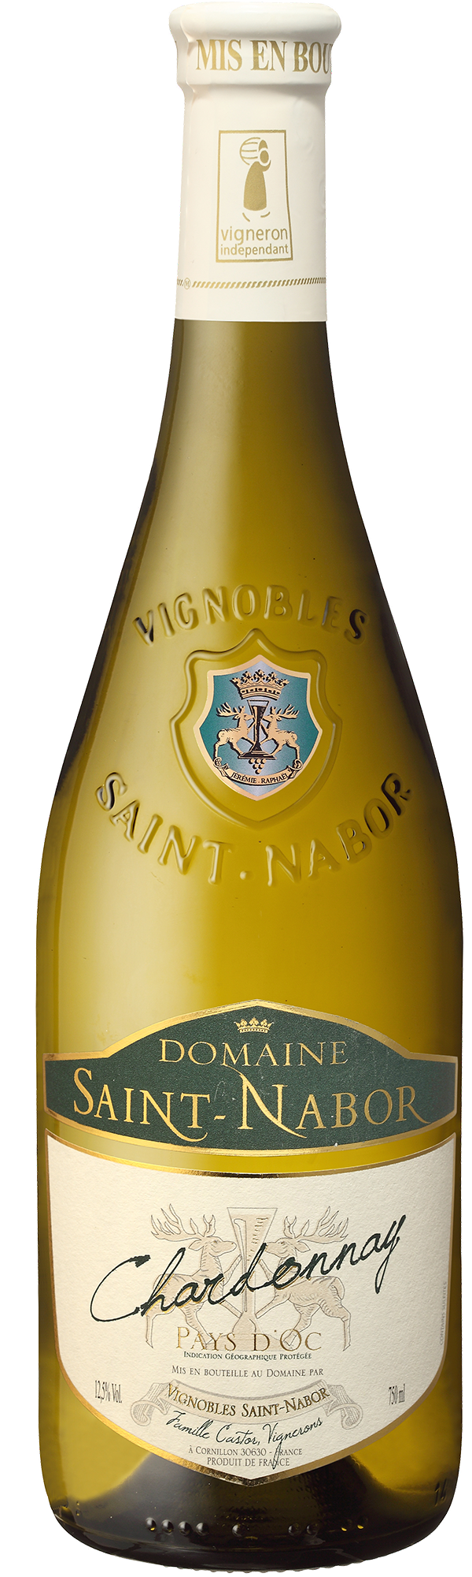
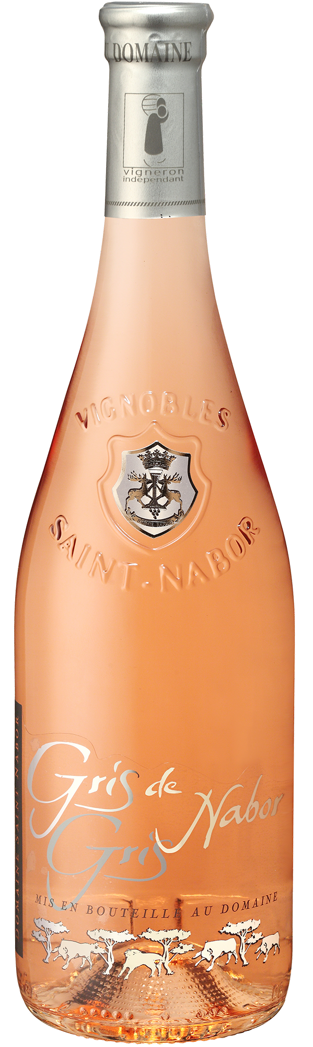
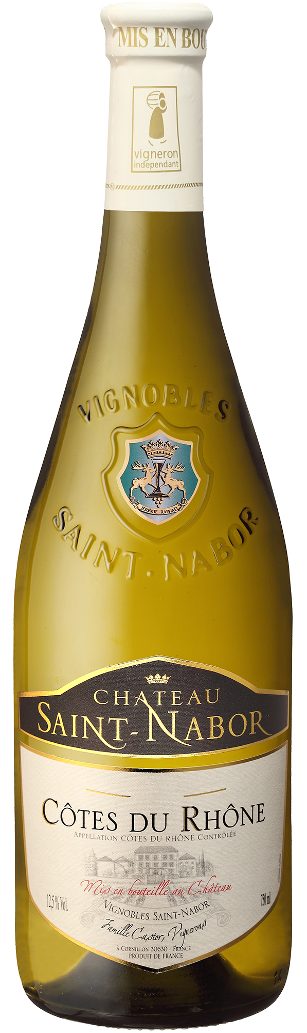
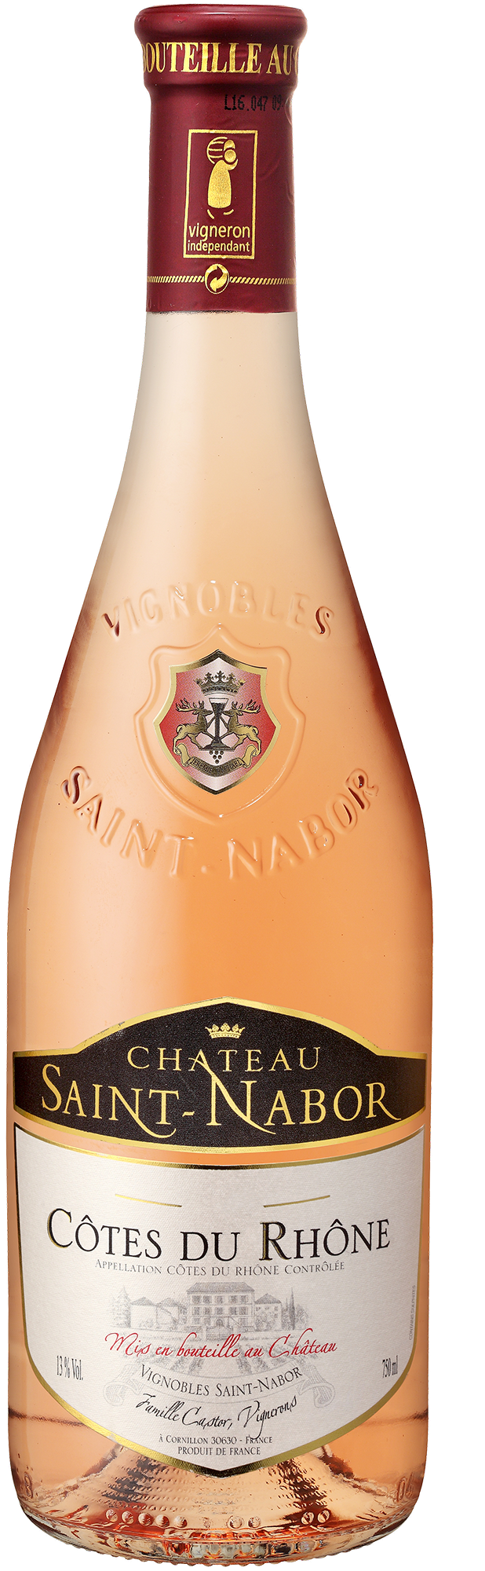
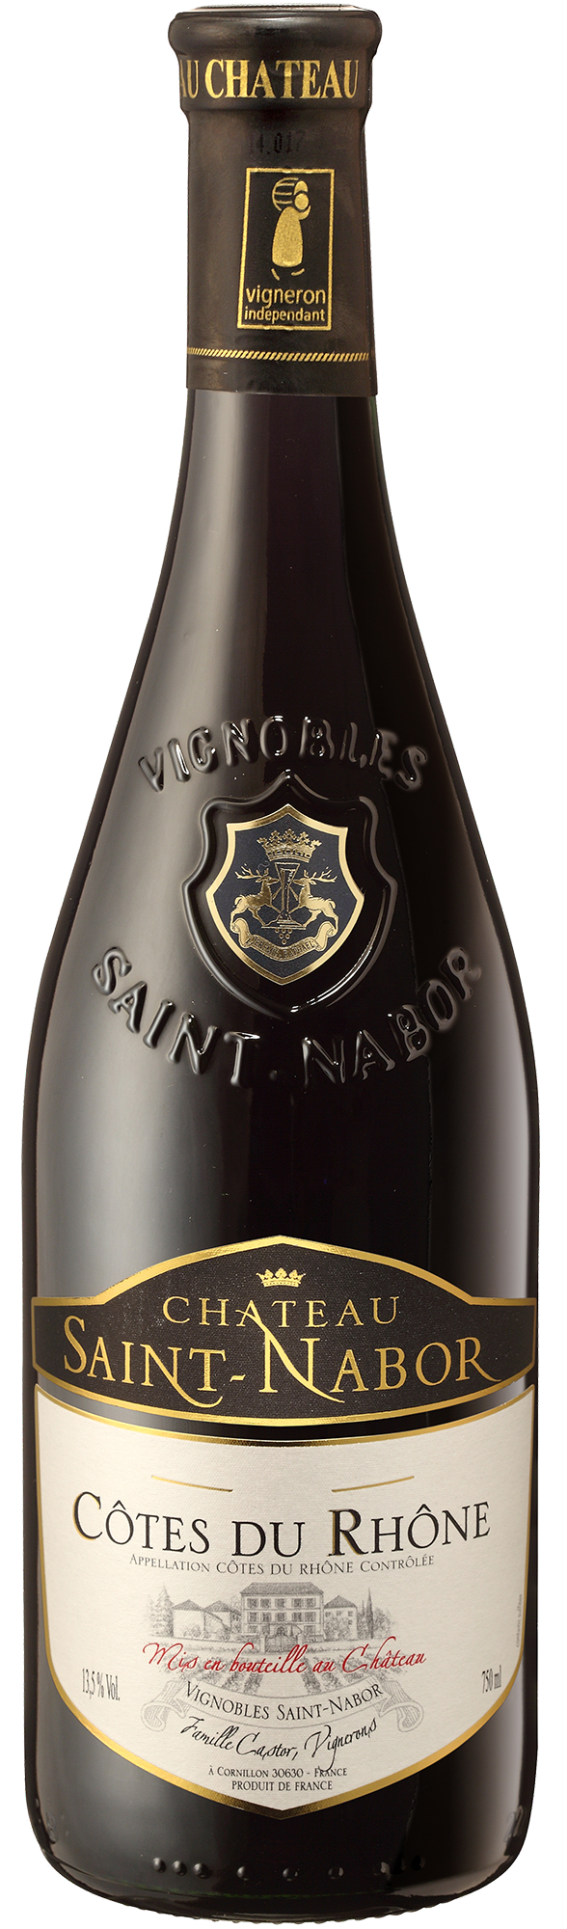
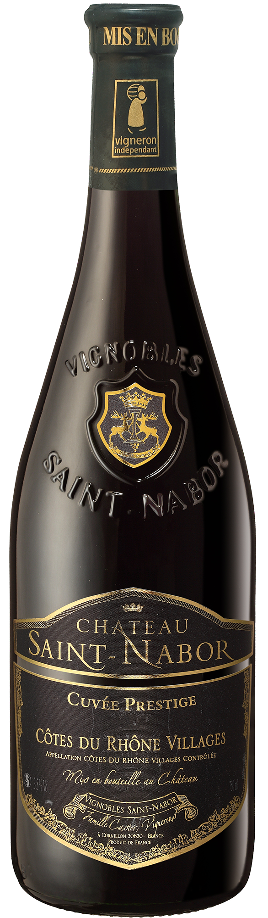

Slide 13
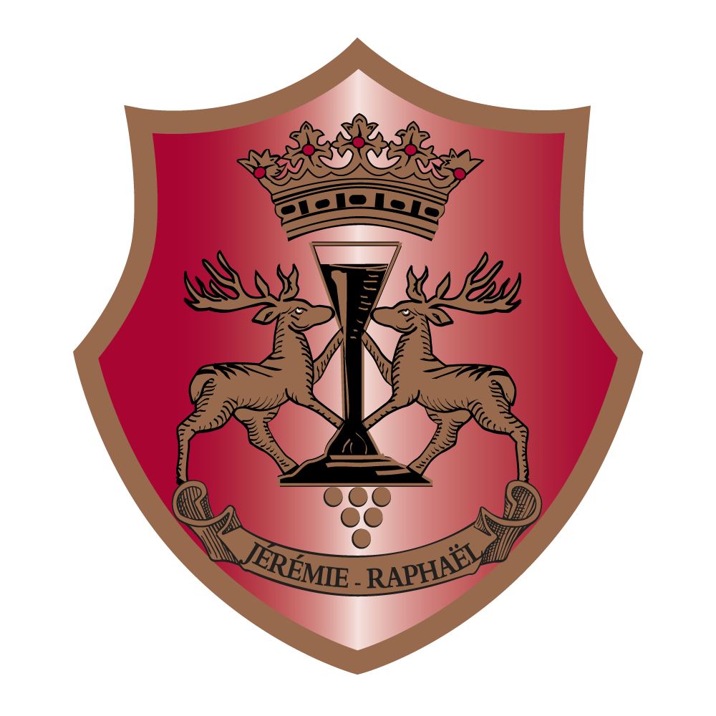
Proudly imported by Marquee Selections
www.marqueewines.com • @marqueewines
Inquiries, contact: Bryce Gillespie
bryce@marqueewines.com • 503.313.9180

